Slide 1

The crop compass: Navigating Agriculture Through data

Slide 2
Agenda -
What is Power BI?
What are the key Features of Power BI?
Overview of Data
Dashboard
Insights

Slide 3

What is Power BI?
Power BI is a data analysis tool that involves technologies and practices for collecting, integrating, analyzing, and presenting business data to support decision-making
Power BI provides interactive visualizations, business intelligence capabilities, and self-service analytics

Slide 4
What are the key Features of Power BI?
Data integration - seamlessly connect with various data sources for comprehensive analysis
Data visualization - transform raw data into interactive dashboards and reports
Real-time insights - access and analyze up-to-date data for informed decision-making
Self-service analytics - empowers users of all levels to analyze data without technical expertise
Collaboration - easily share reports and collaborate on data projects with colleagues
Accessibility - access the data and insights anytime, anywhere, on any device
AI integration - leverage built-in AI for automated insights and recommendations
Data Security - prioritize data security and compliance with encryption and access control

Slide 5

Overview of Data
This dataset explores the impact of climate change on agricultural productivity across various regions. It includes data on temperature, precipitation, and crop yields to understand how shifting climate patterns affect agriculture.

Slide 6
Dashboard
Dashboard is a single page, often called as canvas that uses visualizations to tell the story of your data

Slide 7
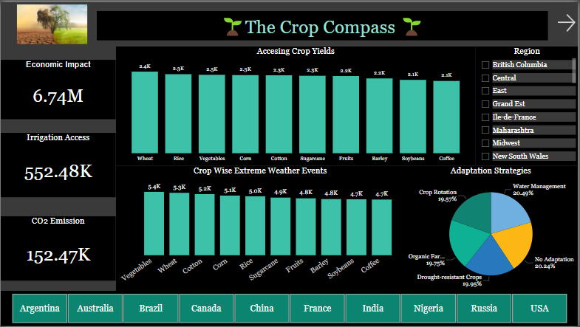

Slide 8
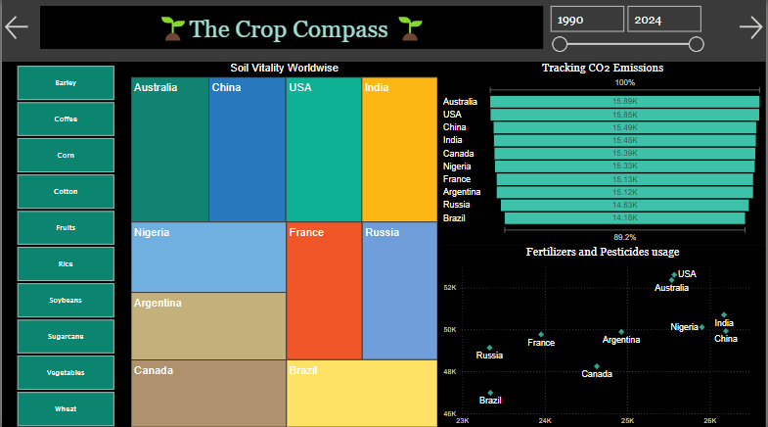

Slide 9
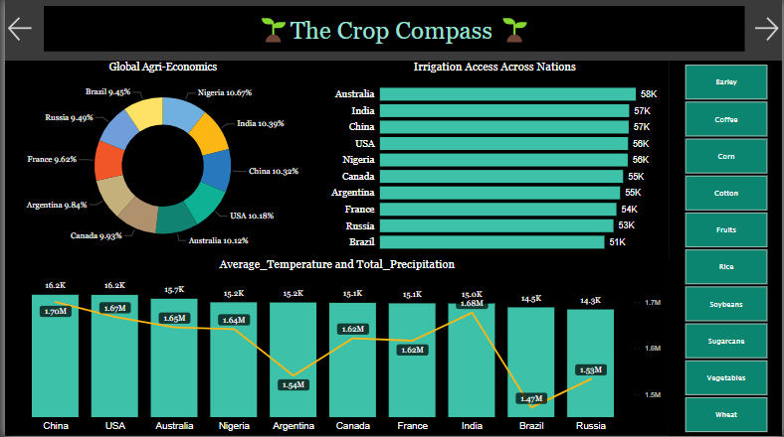

Slide 10
Understanding Each Visual

Slide 11
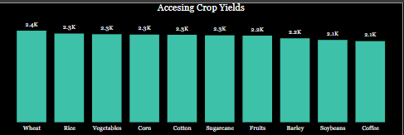
Accessing Crop Yields A Column Chart analyzing trends on crop. The analysis helps to identify high-yield regions.

Slide 12
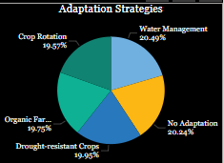
Adaption Strategies A Pie Chart showing the percentage of adaption strategies that are followed for the crop yielding

Slide 13
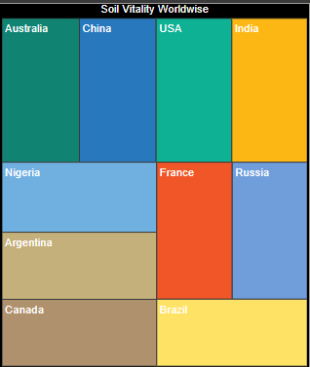
Soil Volatility Worldwide A Tree-map Chart showing the distribution of countries as per the soil health index

Slide 14
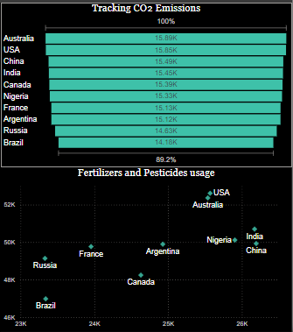
Tracking CO2 Emission A Funnel Chart showing Country-wise CO2 Emission
Fertilizer and Pesticides usage A Scatter Plot indicating the usage of fertilizers and pesticides

Slide 15
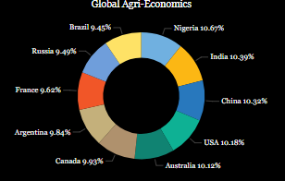
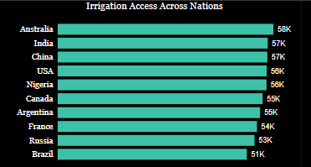
Global Agri Economics A Donut Chart representing economic impact of agriculture on countries
Irrigation Access Across Nations A Bar Chart giving the count of irrigation Access as per the country

Slide 16
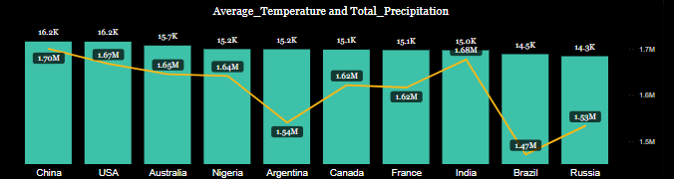
Average Temperature and Total Precipitation A Combo Chart in which Line chart shows the Average Temperature and Column Chart shows the Total Precipitation of each country

Slide 17
Insights
Crop Yield : The analysis helps to identify high-yield regions, assess the impact of inputs on yield, and improve crop management strategies.
Soil Health Index : Visualizations track soil quality metrics. This helps to understand how soil conditions affect crop yields and identifies regions at risk of soil degradation.
Climate Impact (Average Temperature and Total Precipitation) : Data on temperature fluctuations and precipitation levels provide insights into climate trends affecting crop growth cycles. Temperature and precipitation patterns are analyzed to predict agricultural productivity and optimize planting schedules.

Slide 18
Fertilizer and Pesticide Usage : This section examines the types and quantities of fertilizers and pesticides used across different regions. It highlights the balance between enhancing crop growth and minimizing environmental impact, emphasizing sustainable agricultural practices.
Global Agricultural Economics : A comparative analysis of agricultural economies worldwide, showcasing the economic impact of crop production on various regions and their contribution to global food supply.

Slide 19
THANK YOU

